Slide 1
The Impossible Perspective of M.C. Escher
By: Chris Thompson

Slide 2
General
Analyze some of Escher’s work
Look for similarities

Slide 3
Drawing is Deception
Appealing about impossibility

Slide 4
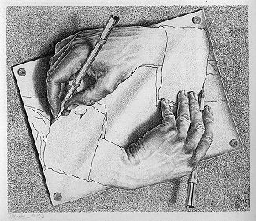
Drawing Hands
Mutual construction

Slide 5
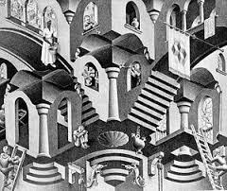
Convex and Concave

Slide 6
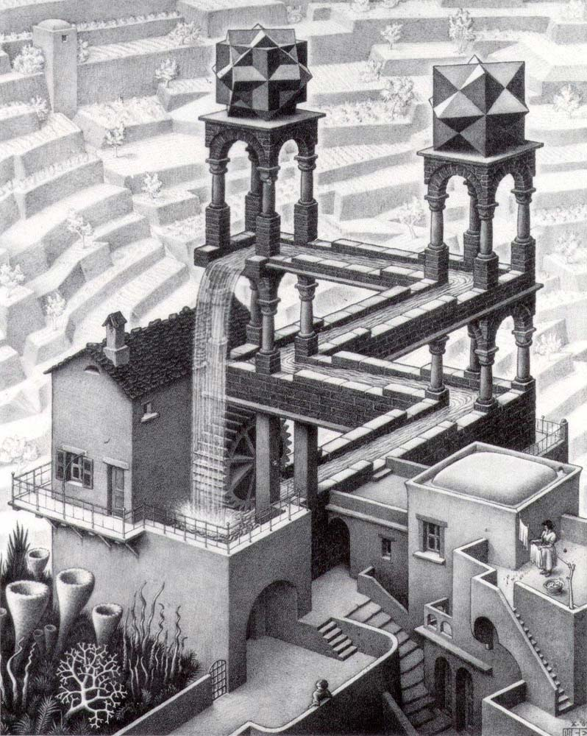
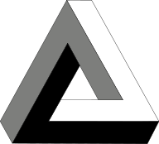
Waterfall

Slide 7
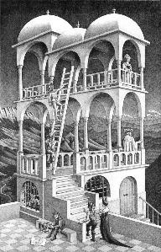
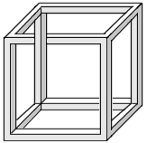
Belvedere

Slide 8
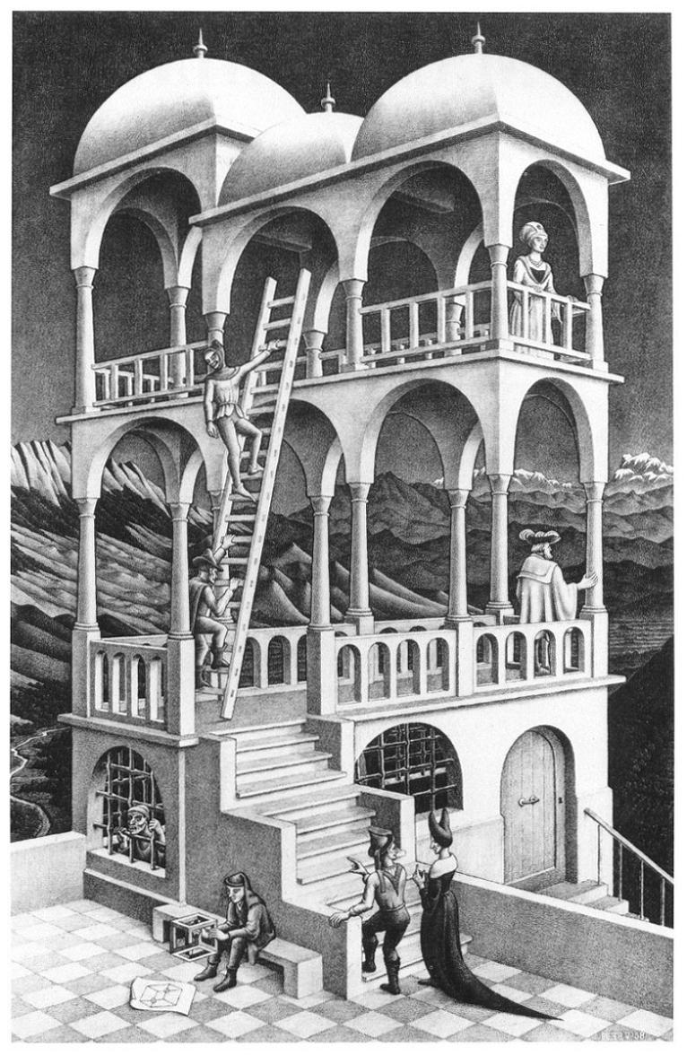
Belvedere vs Convex and Concave

Slide 9
Belvedere vs Waterfall

